Slide 1
Deferred Texturing
Обзор

Slide 2
Engines
Dawn Engine
Activision Geometry Pipeline
Nanite
Decima

Slide 3
Forward Shading
One shader to rule them all
+ low bandwidth
+ very simple to set up
+ works on everything
+ very fast (with some assumptions)
Giant ubershaders
Lots of overshading
Tons of permutations (which leads to ubershaders to compensate)
Light culling is hard (solved in F+)

Slide 4
Forward Shading
What to do?
Depth prepass
+ no overshading for invisible geo
X2 DIPs
X2 vertex shader invocations (geo processing happens at least twice)
Tiled light clustering
+ Solves light culling and removes extra DIPs for multiple lights
Shaders are more complex
Dependent samples into light buffers
Requires full prepass

Slide 5
Forward Shading
Modern examples:
ID Tech
IW Engine
Quantic Dream internal game engine

Slide 6
Deferred Shading
Separate lighting from geo + materials
+ Lighting is coherent
+ Simpler shaders
+ Less permutations
+ No overshading
High Bandwidth (fat Gbuffers)
Still X2 geo (prepass)
Material code is mixed with geo
Bad quad efficiency for dense geo
Limited shading models

Slide 7
Deferred texturing
Separate geo from everything else
Render geo information in Visibility Buffer (triangle id, derivatives, barycentrics)
Apply materials in a full-screen pass (or by tiles)

Slide 8
Deferred texturing
+ Geo is separated from materials (less permutations)
+ Only one geo pass (no prepass)
+ Simpler vertex shaders (no interpolators)
+ Great quad efficiency for material calculations
+ No material overshading
+ Everything with the same material can be merged to one DIP (especially with dynamic indexing/bindless rendering from VK/DX12)
+ Ideal for dense geo

Slide 9
Deferred texturing
Setup is much harder
No HW derivatives in a material pass
Need to find pixels to shade in a material pass
Still no MSAA
Harder to support extra vertex attributes and move some calculations to vertex shader
Performs badly on older hardware (no atomics, no TriangleID in pixel shaders, no dynamic indexing for textures)

Slide 10

Dawn Engine

Slide 11
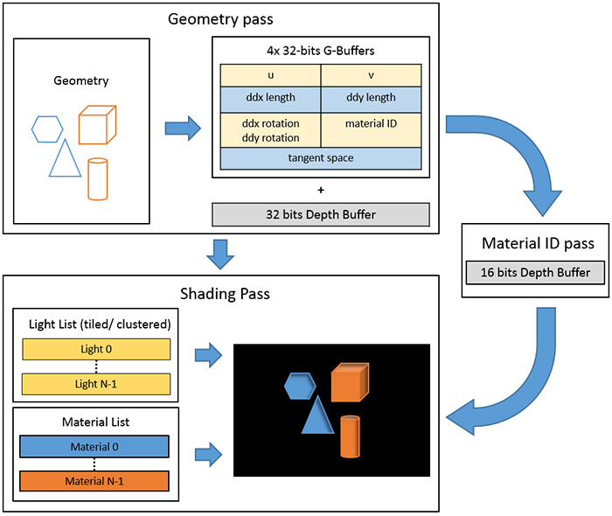
Dawn Engine
Fat visibility buffer
Forward+ shading
Decomposed ddx/ddy (16bit length, 8 bit rotation)
TBN in axis-angle
Depth-test trick to separate materials from each other

Slide 12
Dawn Engine
Abusing Z-test to shade materials
Write material ID to a separate 16bit depth buffer
Depth test func = D3D12_COMPARISON_FUNC_EQUAL
Draw material as a full-screen quad with Z = Material ID
Free per-pixel HW culling!
Free acceleration using HTILE on consoles!

Slide 13
Dawn Engine
Pros
+ Extra info for lighting (vertex normals, DDX/DDY In decal passes)
+ Free anisotropy compared to deferred (because of stored TBN)
+ Quite Simple (no reconstruction in material pass)
+ No GBuffer
Cons
Almost no vertex attributes (1 uv channel and that’s all)
Fat vis buffer (4 32bit RT)

Slide 14
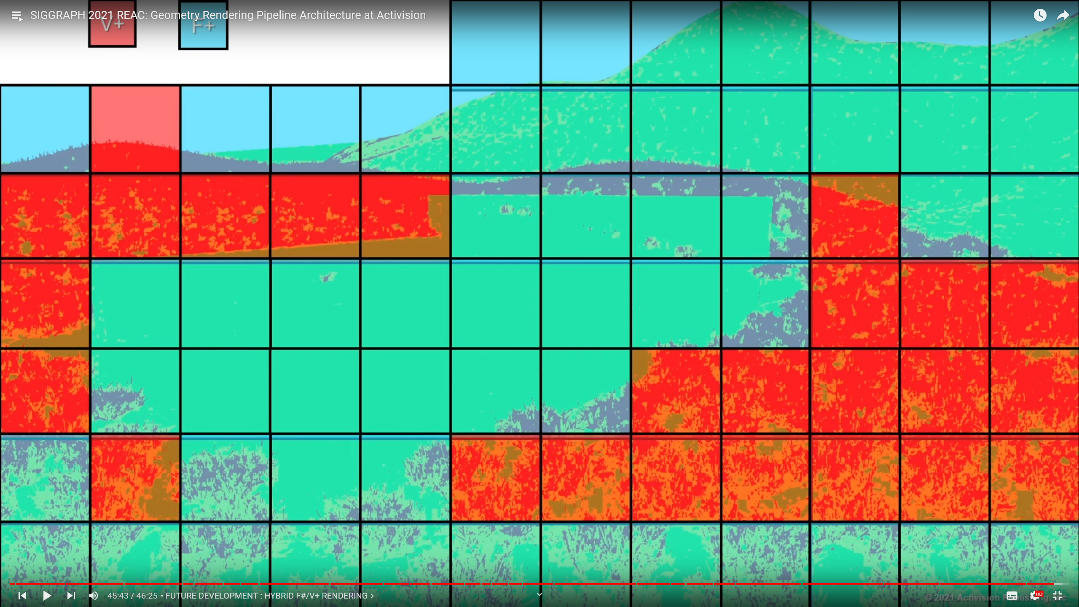
Activision Geometry Rendering Pipeline
Hybrid
V+ for dense meshes with simple vertex format and foliage
Split meshes into clusters for fine culling and small memory footprint (no need for 32 bit index buffers)

Slide 15
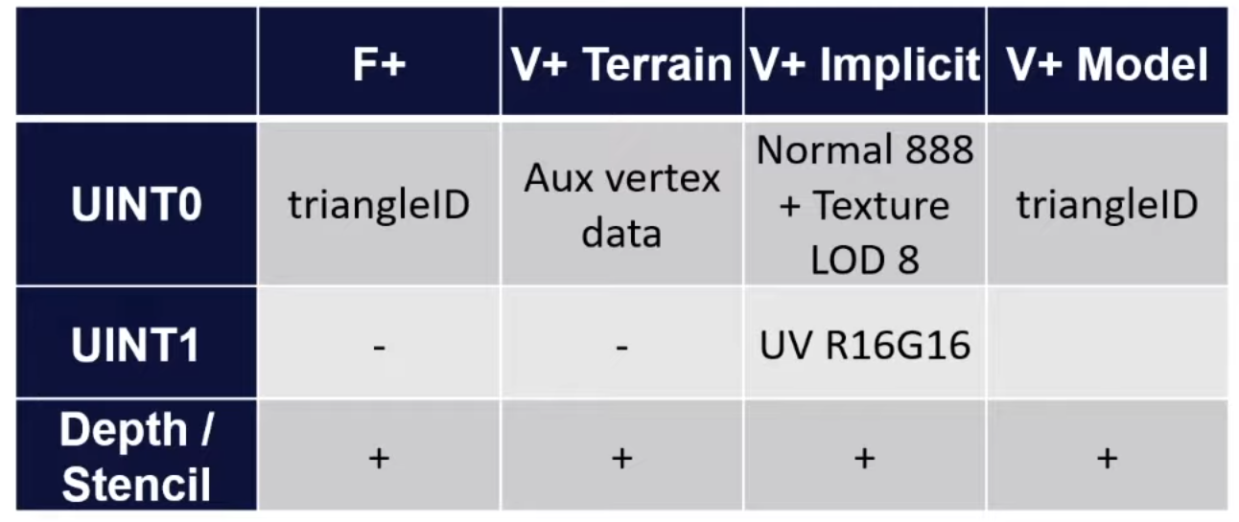
Activision Geometry Rendering Pipeline
Vbuffer Layout
2 Vbuffers
4 kinds of data depending on the surface in the same buffer
Terrain reconstructs everything from depth
Deformable geo reads from 2 V+ buffers
Regular geo reconstructs full triangle
TriangleID contains material and mesh info in higher bits (possible because the meshes are divided into small clusters)

Slide 16
Activision Geometry Rendering Pipeline
Pros and cons
Setup is HARD
Same Depth trick as in Dawn Engine to filter materials
Vertex Indexing is disabled to get Triangle ID in a pixel shader (not a problem with new consoles) (Horizon bypasses this with some tricks)
Thin Vbuffer (1 32bit buffer for everything except deformable geo)
Effective (x10 geo in a frame compared to regular f+)
All geo data needs to be accessible on the gpu in a pixel shader
No mesh shaders

Slide 17
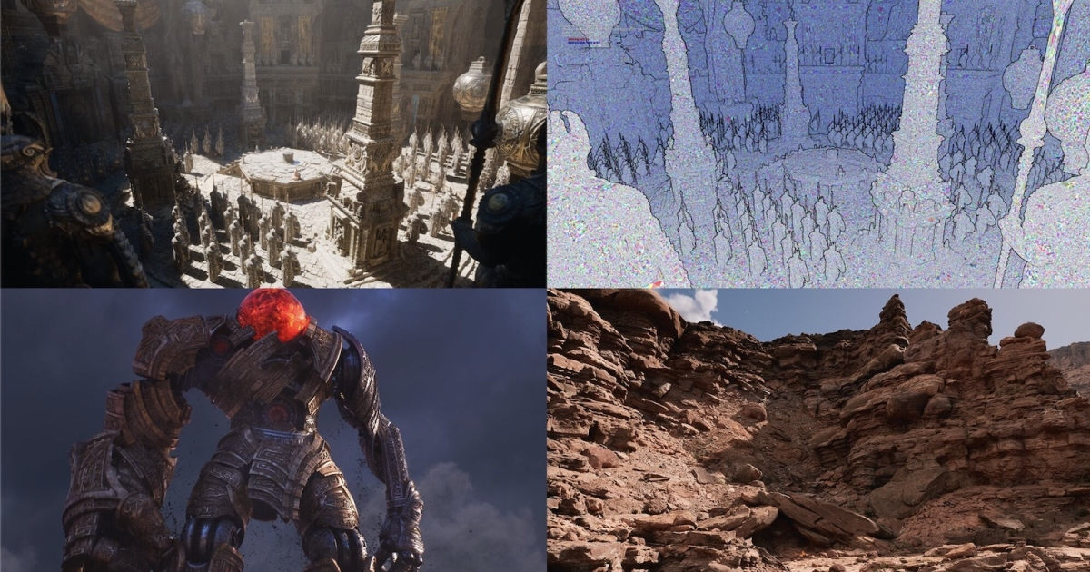
Nanite
Deferred shading
Aimed at tiny triangles and VERY dense meshes (multiple million triangles per mesh)
Covers a lot of stuff besides visbuffer (virtual geometry, lod generation, lod transition, culling, etc)
Software rasterization for small triangles
Requires 64 bit atomics
Allows smaller-than-pixel triangles

Slide 18
Nanite
Vis buffer layout:
Depth
InstanceID
TriangleID
All in a single 64bit texture (to allow UAV atomic rasterization)
No UV/derivatives in vis buffer
Load triangle in pixel shader
Transform to screen
Derive barycentrics & uv derivatives
Load and lerp attributes
Sounds like a lot of work, but actually quite fast
The main reason why deformables aren’t supported yet

Slide 19
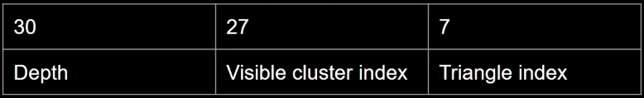
Nanite
Why Depth? We still need regular depth buffer for everything else
Software rasterization
No HW depth test
No HW depth write
Use atomics!
HW rasterization output contains depth in higher bits
InterlockedMax does everything for us
Very fast
Can be done entirely on compute
Not very effective for large triangles

Slide 20
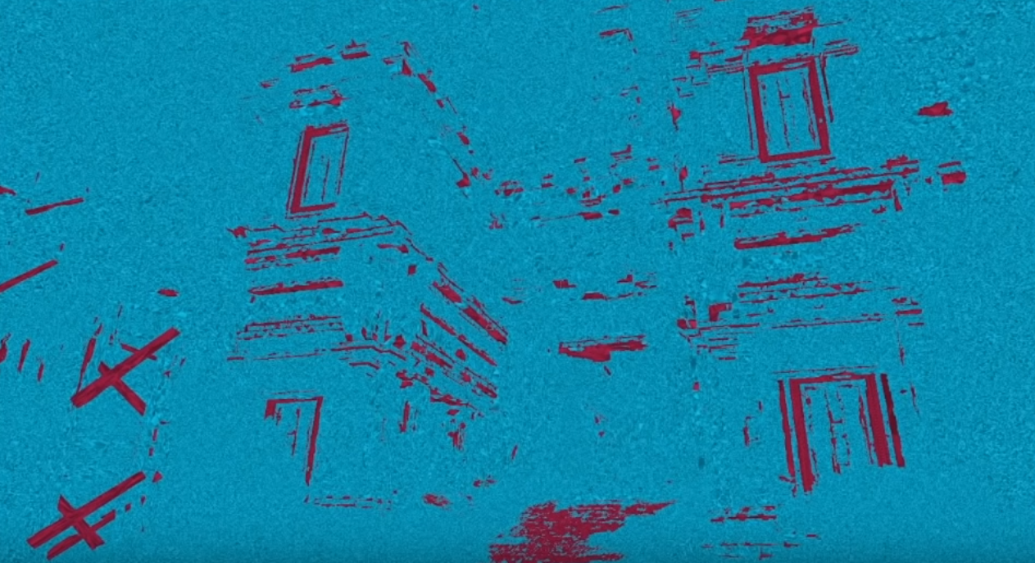
Nanite
SW is not effective on large triangles
Use regular HW raster
But switch UAV->RTV is expensive? (barriers and all)
Don’t bind render targets, output to UAV, same as SW raster!
Blue – SW, Red - HW

Slide 21
Nanite
Materials
Same Z-test trick as before
Analytical derivatives when available
For each attribute that requires a derivative evaluate a gradient across a triangle
Not always possible (something non-linear or discontinious)
Fall back to finite differences (ddx/ddy)
Only for required attributes (can be deduced with material graph)
No ray differentials

Slide 22
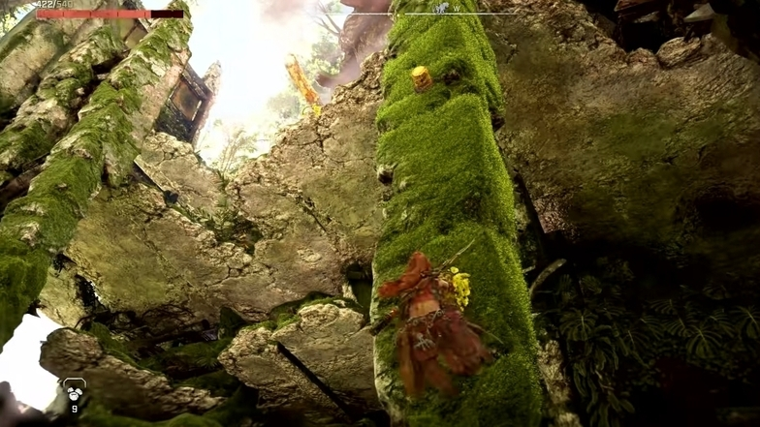
Decima
Aimed primarily at foliage
Handles a lot of moss
Deferred
Almost entirely async compute (to overlap with shadow calculations)
Can’t use depth trick!
Can’t use HW to pack waves with pixel work!

Slide 23
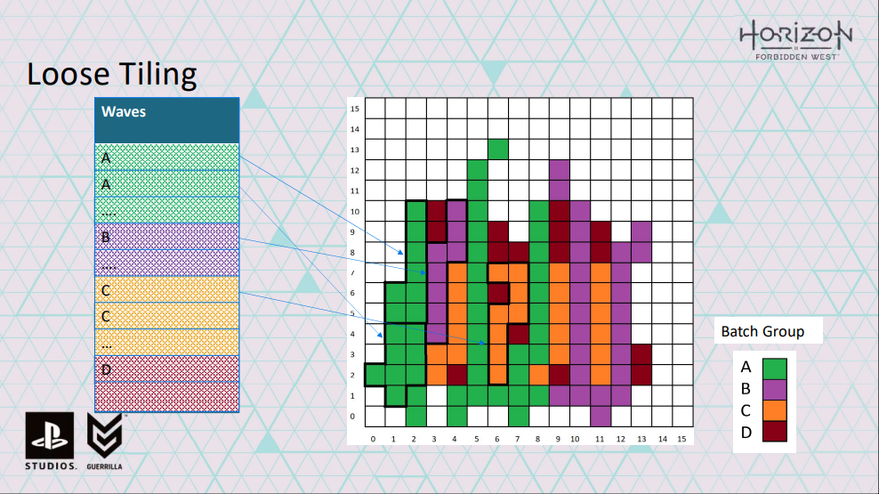
Decima
Solution: pixel command list
Completely avoids quad occupation problem (no quads at all)

Slide 24
Decima
Triangles are large and have complex vertex animation (foliage), don’t want to transform them per pixel
Transform once, store in a ring buffer (12mb on ps4)
Can’t fit all the geometry inside
Transform geo for a few batches, draw to vis buffer, then repeat
Can transform on a separate compute pipe in parallel to vis buffer generation
Foliage system creates giant batches that won’t fit in geo cache
Split to micro-batches

Slide 25
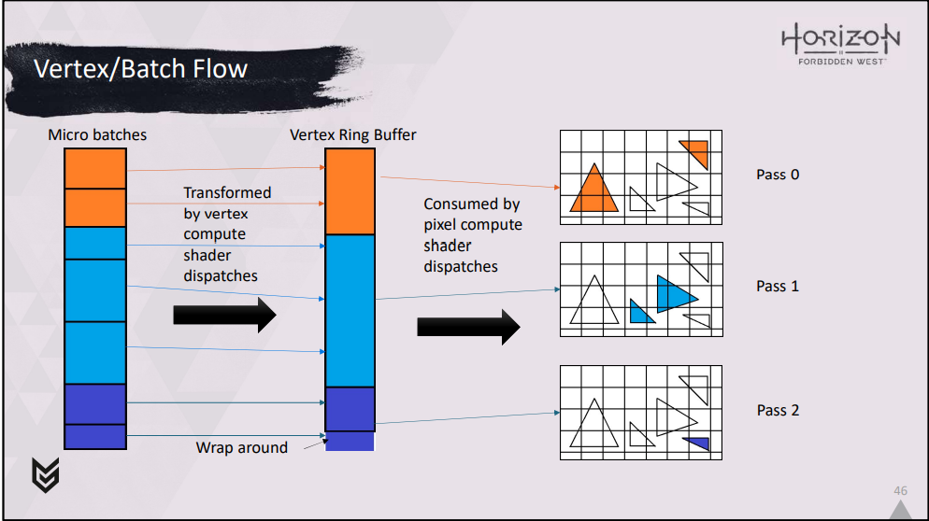
Decima

Slide 26
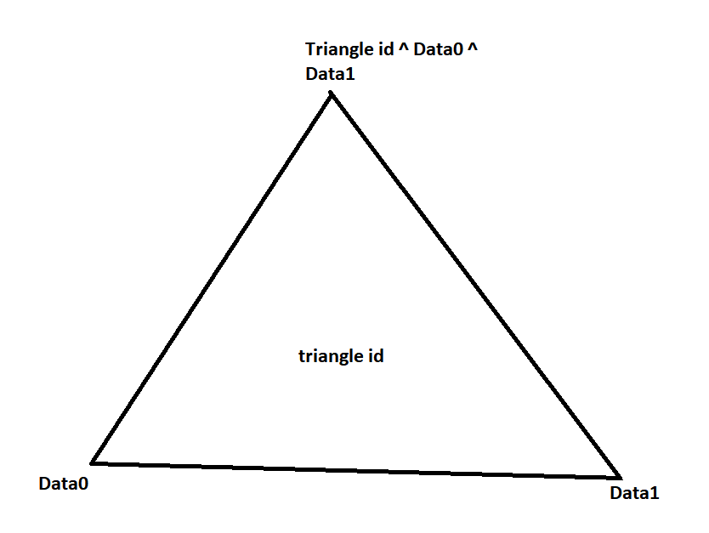
Decima
Vis buffer layout
Single 32 UINT
TriangleID, Instance ID, Batch ID
Triangle ID solution:
TriangleID = Data0^Data1^Data2
Calculate Data0/1/2 offline at mesh generation time
DataN = DataN-2 ^ DataN-1 ^ TriangleID
Duplicate vertices if needed (triangle is on already defined vertices)

Slide 27

Зачем это все?

Slide 28
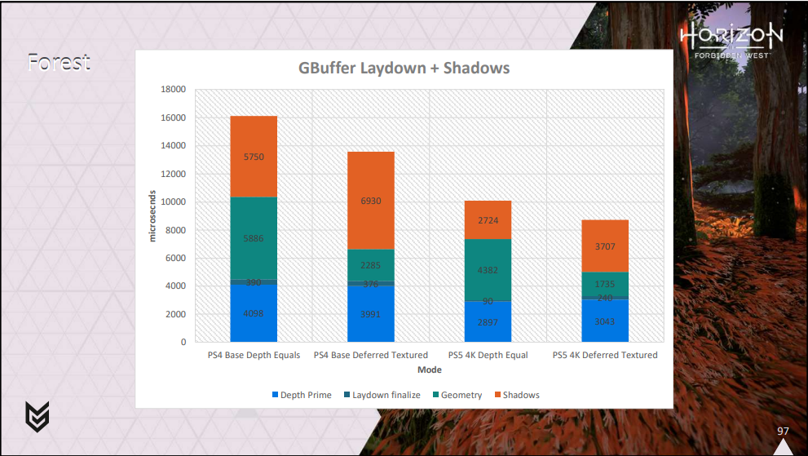
Затем

Slide 29
References
https://www.youtube.com/watch?v=eviSykqSUUw – Deep Dive Into Nanite
https://www.youtube.com/watch?v=NoTUzzmxPo0 – Geometry Rendering Pipeline At Activision
https://www.eidosmontreal.com/news/deferred-next-gen-culling-and-rendering-for-dawn-engine/ - Deferred Texturing in Dawn Engine
https://www.gdcvault.com/play/1027553/Adventures-with-Deferred-Texturing-in - Adventures with Deferred Texturing in 'Horizon Forbidden West'

